Slide 1
Engineering grAPHICS PRESENTation
Name- Saurabh desale
Class- F.Y. B.Tech
Div – E&TC-1 (F)
Roll No :- 32
Guided by- NILESH A PATIL

Slide 2
TOPIC
FIRST and THIRD ANGLE PROJECTION MEHOD

Slide 3
Types of view
FRONT VIEW (F.V.) or ELAVATION
TOP VIEW (T.V.) or PLANE
SIDE VIEW (LEFT OR RIGHT)

Slide 4
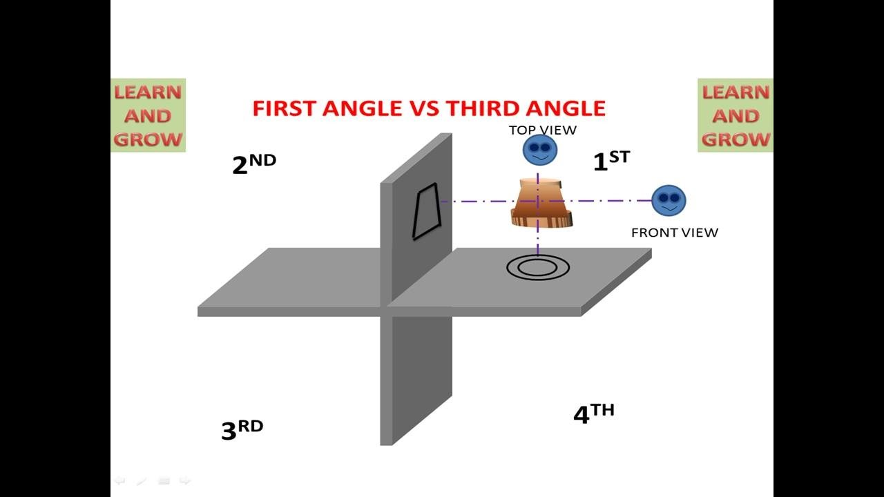

Slide 5
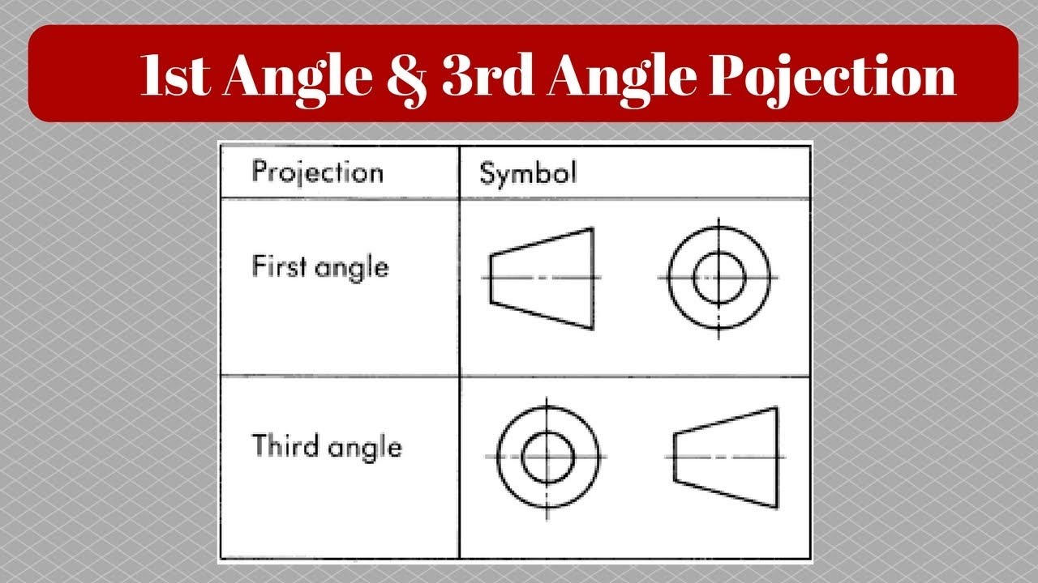
SYMBOLS

Slide 6


